Slide 1
Software Testing and Maintenance Introduction
Wing Lam
SWE 637
George Mason University
Slides adapted from Jeff Offutt

Slide 2
Agenda
Self introduction
What is this class about and why you should take it
Responsibilities and syllabus review
15 min break
Chapter 1 - Why Do We Test Software?
Introduce Assignment 1
https://cs.gmu.edu/~winglam/classes/637/assigns/assign01.html

Slide 3
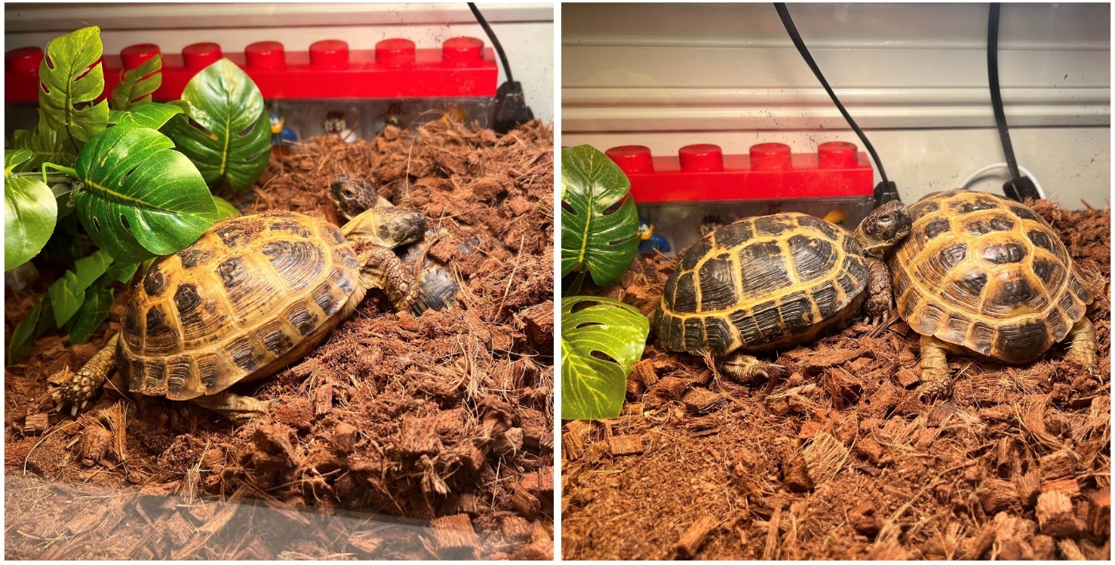
Introduction
Name: Wing Lam Major: Computer science
Where you are from: I grew up in Seattle, WA and attended the University of Washington for my Bachelor's degree in CS. After my Bachelor's, I attended the University of Illinois for my PhD in CS.
Your career goals: Become (and continue being) a good professor.
Why you are taking this class: (Not taking the class, but am teaching it.) Partially to fulfill my duties as a professor but, more importantly, because of my interest to teach.
What you expect to learn: How to best communicate the importance of software maintenance and testing and what are some good ways to teach these concepts.
Fun fact: I have two tortoises: one named Mussels (male, light shell) and the other is Scallops (female, dark shell). They are low-maintenance and fun pets to have (e.g., taking them on walks for them to eat weeds is good for them). The two of them also likes to follow each other around.

Slide 4
In-class exercise
Take turns sharing with a neighboring student, the following:
Name:
Major:
Where you are from:
Your career goals:
Why you are taking this class:
What you expect to learn:
Fun fact:
You may work with as many neighboring students as you want. Every group of students turns in one piece of paper with everyone’s full name and email (you may omit @gmu.edu)

Slide 5
“Traditional” quality attributes (1980s)
Efficiency of process (time-to-market)
Efficiency of execution (performance)
We teach these as priorities in undergraduate computer science classes …
It was true …
in 1985

Slide 6
Modern quality attributes
Reliability
Usability
Security
Availability
Scalability
Maintainability
Performance & Time to market
Why the
change ?
All of these factors
(sometimes called “-ilities”)
are important now
Based on an informal survey of more than a dozen web software development managers, 2000.

Slide 7
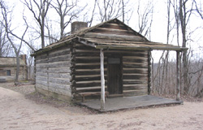
Software projects in the 1960s
In the 1960s we built tiny log cabins …
Single-programmer
Not much complexity
No process needed
Design could be kept
in short term memory

Slide 8
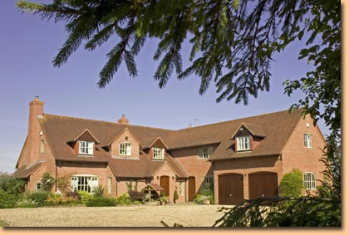
Software projects in the 1970s
In the 1970s we built bigger houses …
Still single-programmer – focus on algorithms and programming
A little more complex
We had to start thinking harder
The lack of process led to some disasters
Quality did not affect the bottom line for most companies
But costs were starting to increase …

Slide 9
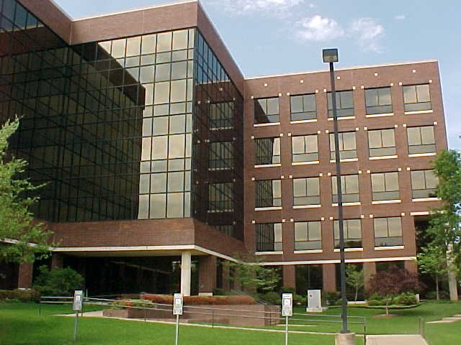
Software projects in the 1980s
In the 1980s we built office buildings …
We needed teamwork – and communication
A lot more complex – data abstraction
We needed to write down requirements and design
Poor process and ignorance of need for process created spectacular failures
We no longer had the skills and knowledge for successful engineering

Slide 10
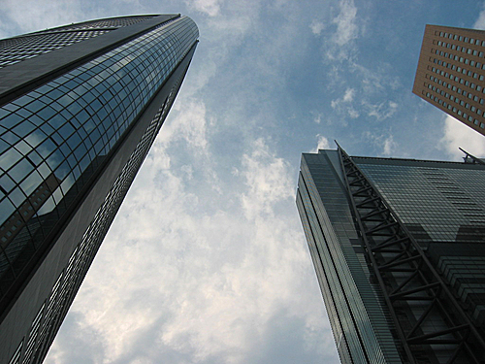
Software projects in the 1990s
In the 1990s we built skyscrapers …
We needed more than teamwork and communication
We needed totally new technologies – languages, modeling techniques, processes
Software development changed completely
New languages (Java, UML, etc) led to revolutionary procedures
Education fell behind …

Slide 11
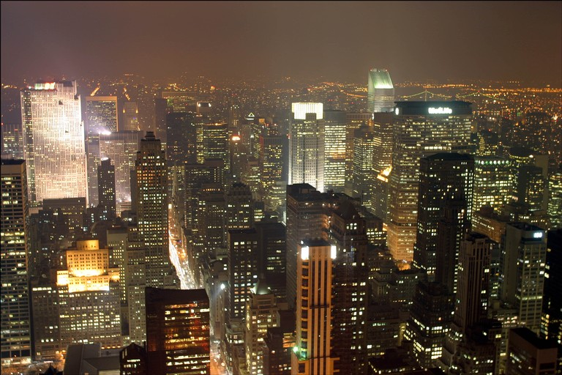
Software projects in the 2000s
In the 2000s we build integrated collections of continuously evolving cities …
Algorithm design and programming is no longer the primary focus of software development
CS education fell so far behind it became obsolete
New applications (web, embedded) is making quality crucial
Developers learn more from training courses than they did in college
Not much new development

Slide 12
Pace of change is exhilarating
We have gone from …
Log cabins … to houses … to office buildings …to skyscrapers … to building the most complicated engineering systems in human history
In just half a career !!
Civil engineers took thousands of years for this kind of change
And the most complicated civil engineering products pale in comparison the complexity of a modern IT system
Electrical engineers took a couple of centuries
No way researchers, educators, or engineers could keep up !

Slide 13
Theory, practice, and education
What have you learned in college ?
How to build houses
General software engineering courses (SWE 321) introduce a few concepts about buildings
The way we build software has changed dramatically since the CS curriculum stabilized in 1980 !!!!
Very little new development is being done
Maintenance … evolution … re-engineering … maintainability … being “agile”

Slide 14
What can you do?
As a developer …
Program very neatly
Design to make change easy
Follow processes that make change easy
As a professional …
Listen to your colleagues when they teach you things you didn’t learn in college
Take training classes eagerly (in the next 20 years, you should spend more time in training than you spent in college CS courses)
Further your education (MS degree)

Slide 15
Current reality
Most software development is actually maintenance
“Evolution” is probably more accurate
Evolution is not as boring as it was in the 1980s
“We have as many testers as we have developers. And developers spend half their time testing. We’re more of a testing organization than we're a software organization.”
Bill Gates of Microsoft
This class teaches modern methods for a dominant portion of software development:
Reliability & Testing

Slide 16
Agenda
Self introduction
What is this class about and why you should take it
Responsibilities and syllabus review
15 min break
Chapter 1 - Why Do We Test Software?
Introduce Assignment 1
https://cs.gmu.edu/~winglam/classes/637/assigns/assign01.html

Slide 17
Responsibilities of teaching staff
Prepare useful and interesting knowledge for you
Post materials on class website before class
Come to class on time, prepared to teach
Offer challenging but reasonable assignments and tests
Grade fairly without bias
Return graded work promptly with educational comments
Quizzes will be returned one class after it was taken
Assignments will be returned within 3 weeks after the original due date
In-class exercises will be graded within one class
Goals :
Have interesting lectures
Make the class fun
Use technology appropriately

Slide 18
Responsibilities of students
Come to class on time
15% of your grade will be from class attendance/participation
If you miss a class, learn material on your own
Listen to all instructions
Turn in assignments on time
Ask for help when you’re confused
Read the material
If you disagree with my policies, disagree politely
Goals :
Read before class
Learn enough to earn a good grade

Slide 19
Taking notes
The slides summarize the material
My words emphasize highlights
We learn a lot by transferring information
Through our ears
To our brains
To our pencils and onto paper
Unless you have a perfect memory, notes are expected
Paper and pencil will also be needed for in-class exercises!
Taking notes will make a difference in your performance

Slide 20
Electronic communication devices
Mobile phones, PDAs, beepers, laptops …
Texting, IMming, Email, web surfing …
These are all great tools – out of the classroom
In the classroom, they
Distract the professor
Annoy your classmates
Interfere with your ability to learn
Computers can be used anytime I am not lecturing
Other gadgets should be silent and put away

Slide 21
Reading
Books have knowledge
Professors are simply guides
Information : comes from lectures
Knowledge : comes from books and homeworks
Wisdom : comes from experience
Read, Read, Read …

Slide 22
Review syllabus
https://cs.gmu.edu/~winglam/classes/637
Course staff
Office hours
Textbook requirements
Pre-requisites
Grading formula
Assignment deadlines
Quiz retakes

Slide 23
In-class exercise
Answer the questions in the following with a neighboring student:
https://cs.gmu.edu/~winglam/classes/637/inClass/week1-SCI.html
You may work with as many neighboring students as you want. Every group of students turns in one piece of paper with everyone’s full name and email (you may omit @gmu.edu)

Slide 24
Other notes about syllabus
Please make sure you understand the following if you decide to take this course:
What this course is expected to teach you (e.g., theory vs. practice)
What this course assumes you know already (e.g., sufficient Java, JUnit, and Maven understanding)
In-class quizzes are meant to be difficult; in prior semesters, most students retake many of the quizzes
If you are getting around 80% on each quiz, you are likely doing fine
From prior semesters, roughly 75% got B or higher

Slide 25
Agenda
Self introduction
What is this class about and why you should take it
Responsibilities and syllabus review
15 min break
Chapter 1 - Why Do We Test Software?
Introduce Assignment 1
https://cs.gmu.edu/~winglam/classes/637/assigns/assign01.html

Slide 26
Testing in the 21st Century
Software defines behavior
network routers, finance, switching networks, other infrastructure
Today’s software market :
is much bigger
is more competitive
has more users
Embedded Control Applications
airplanes, air traffic control
spaceships
watches
ovens
remote controllers
Agile processes put increased pressure on testers
Programmers must unit test – with no training or education!
Tests are key to functional requirements – but who builds those tests ?
Industry is going through a revolution in what testing means to the success of software products
PDAs
memory seats
DVD players
garage door openers
cell phones

Slide 27
Software Faults, Errors & Failures
Software Fault : A static defect in the software
Software Failure : External, incorrect behavior with respect to the requirements or other description of the expected behavior
Software Error : An incorrect internal state that is the manifestation of some fault
Faults in software are equivalent to design mistakes in hardware.
Software does not degrade.

Slide 28
Fault, Failure, and Error Example
A patient gives a doctor a list of symptoms
Failures
The doctor tries to diagnose the root cause, the ailment
Fault
The doctor may look for anomalous internal conditions (high blood pressure, irregular heartbeat, bacteria in the blood stream)
Errors
Most medical problems result from external attacks (bacteria, viruses) or physical degradation as we age.
Software faults were there at the beginning and do not “appear” when a part wears out.

Slide 29
A Concrete Example
What is wrong with numZero?
Fault: Should start searching at 0, not 1
public static int numZero (int [ ] arr)
{ // Effects: If arr is null throw NullPointerException
// else return the number of occurrences of 0 in arr
int count = 0;
for (int i = 1; i < arr.length; i++)
{
if (arr [ i ] == 0)
{
count++;
}
}
return count;
}
Test 1
[ 2, 7, 0 ]
Expected: 1
Actual: 1
Error: i is 1, not 0, on the first iteration
Failure: none
Test 2
[ 0, 2, 7 ]
Expected: 1
Actual: 0
Error: i is 1, not 0
Error propagates to the variable count
Failure: count is 0 at the return statement

Slide 30
In class exercise
https://cs.gmu.edu/~winglam/classes/637/inClass/week1-whatILearnedCh1.html

Slide 31
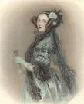

The Term Bug
Bug is used informally
Sometimes speakers mean fault, sometimes error, sometimes failure … often the speaker doesn’t know what it means !
This class will try to use words that have precise, defined, and unambiguous meanings
“an analyzing process must equally have been performed in order to furnish the Analytical Engine with the necessary operative data; and that herein may also lie a possible source of error. Granted that the actual mechanism is unerring in its processes, the cards may give it wrong orders. ” – Ada, Countess Lovelace (notes on Babbage’s Analytical Engine)
BUG
“It has been just so in all of my inventions. The first step is an intuition, and comes with a burst, then difficulties arise—this thing gives out and [it is] then that 'Bugs'—as such little faults and difficulties are called—show themselves and months of intense watching, study and labor are requisite. . .” – Thomas Edison

Slide 32
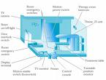
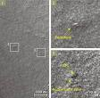

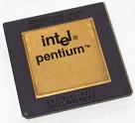
Spectacular Software Failures
NASA’s Mars lander: September 1999, crashed due to a units integration fault
THERAC-25 design
Mars Polar Lander crash site?
THERAC-25 radiation machine : Poor testing of safety-critical software can cost lives : 3 patients were killed
Ariane 5: exception-handling bug : forced self destruct on maiden flight (64-bit to 16-bit conversion: about 370 million $ lost)
Ariane 5 explosion : Millions of $$
Intel’s Pentium FDIV fault : Public relations nightmare
We need our software to be dependable
Testing is one way to assess dependability

Slide 33

Northeast Blackout of 2003
508 generating units and 256 power plants shut down
Affected 10 million people in Ontario, Canada
Affected 40 million people in 8 US states
Financial losses of
$6 Billion USD
The alarm system in the energy management system failed due to a software error and operators were not informed of the power overload in the system

Slide 34
Costly Software Failures
NIST report, “The Economic Impacts of Inadequate Infrastructure for Software Testing” (2002)
Inadequate software testing costs the US alone between $22 and $59 billion annually
Better approaches could cut this amount in half
Huge losses due to web application failures
Financial services : $6.5 million per hour (just in USA!)
Credit card sales applications : $2.4 million per hour (in USA)
In Dec 2006, amazon.com’s BOGO offer turned into a double discount
2007 : Symantec says that most security vulnerabilities are due to faulty software
World-wide monetary loss due to poor software is staggering

Slide 35
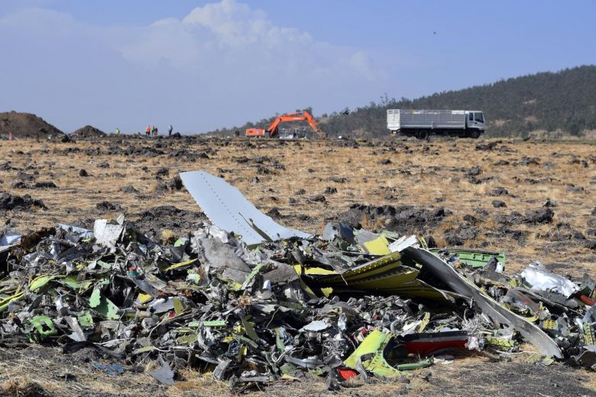
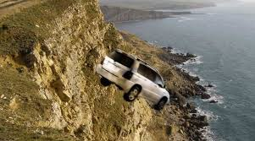
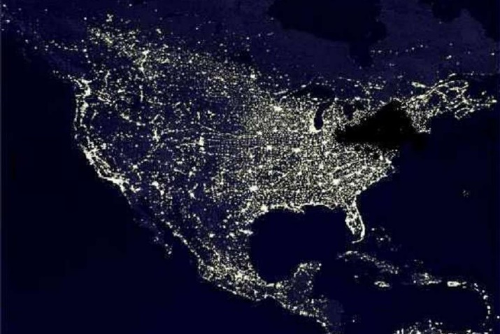
Spectacular software Failures
Boeing A220 : Engines failed after software update allowed excessive vibrations
Boeing 737 Max : Crashed due to overly aggressive software flight overrides (MCAS)
Toyota brakes : Dozens dead, thousands of crashes
Healthcare website : Crashed repeatedly on launch—never load tested
Northeast blackout : 50 million people, $6 billion USD lost … alarm system failed
Software testers try to find faults before the faults find users

Slide 36
Testing in the 21st Century
More safety critical, real-time software
Embedded software is ubiquitous … check your pockets
Enterprise applications means bigger programs, more users
Paradoxically, free software increases our expectations !
Security is now all about software faults
Secure software is reliable software
The web offers a new deployment platform
Very competitive and very available to more users
Web apps are distributed
Web apps must be highly reliable
Industry desperately needs our inventions !

Slide 37
The True Cost of Software Failure
Fail watch analyzed news articles for 2016
606 reported software failures
Impacted half the world’s population
Cost a combined $1.7 trillion US dollars
Poor software is a significant drag on the world’s economy
Not to mention frustrating

Slide 38
What Does This Mean?
Software testing is getting more important
What are we trying to do when we test?
What are our goals?

Slide 39
Validation & Verification (IEEE)
Validation : The process of evaluating software at the end of software development to ensure compliance with intended usage
Verification : The process of determining whether the products of a given phase of the software development process fulfill the requirements established during the previous phase
IV&V stands for “independent verification and validation”

Slide 40
Agenda
Self introduction
What is this class about and why you should take it
Responsibilities and syllabus review
15 min break
Chapter 1 - Why Do We Test Software?
Introduce Assignment 1
https://cs.gmu.edu/~winglam/classes/637/assigns/assign01.html
Quiz 1 next Thurs.
Assignment 1 is due Aug. 31st 11:59PM

